Slide 1
DEMO DAY - SLIDE (1 min)

Slide 2





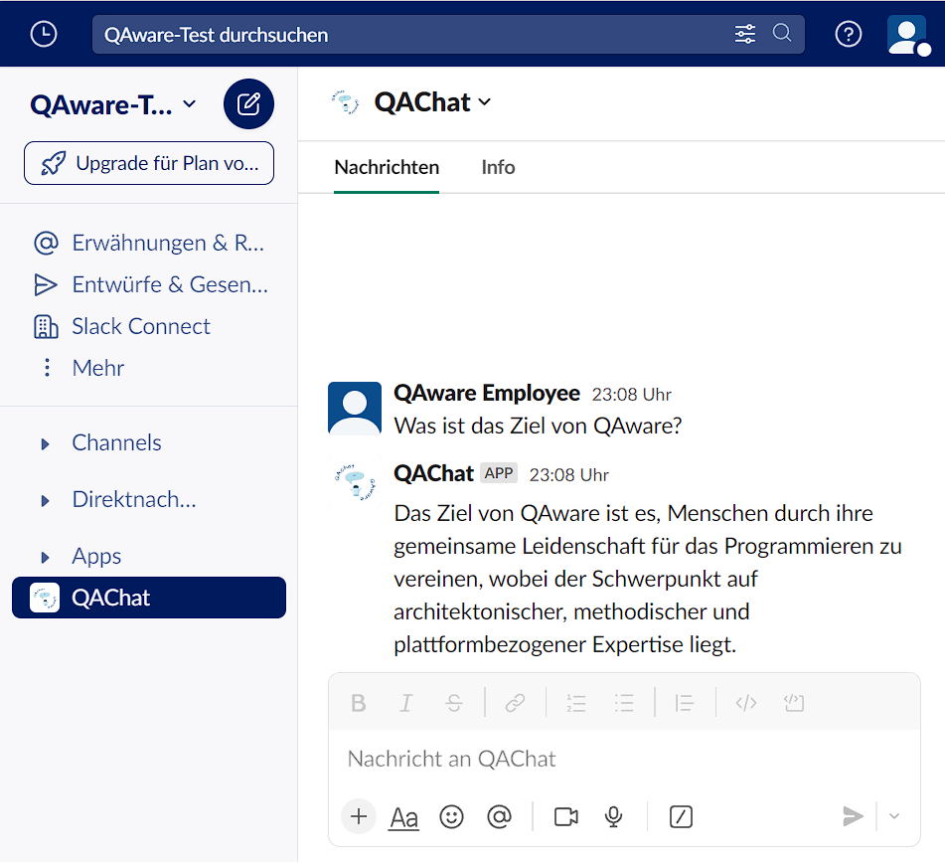


QAChat
Chatbot on Slack is based on a LLM and company-internal information.
Data retrieved from company’s Confluence, Slack and Google Drive.
Employees can ask the chatbot questions about the company.
🤖
💾
🗨️

Slide 3
DEMO DAY - PRESENTATION (10 min)

Slide 5
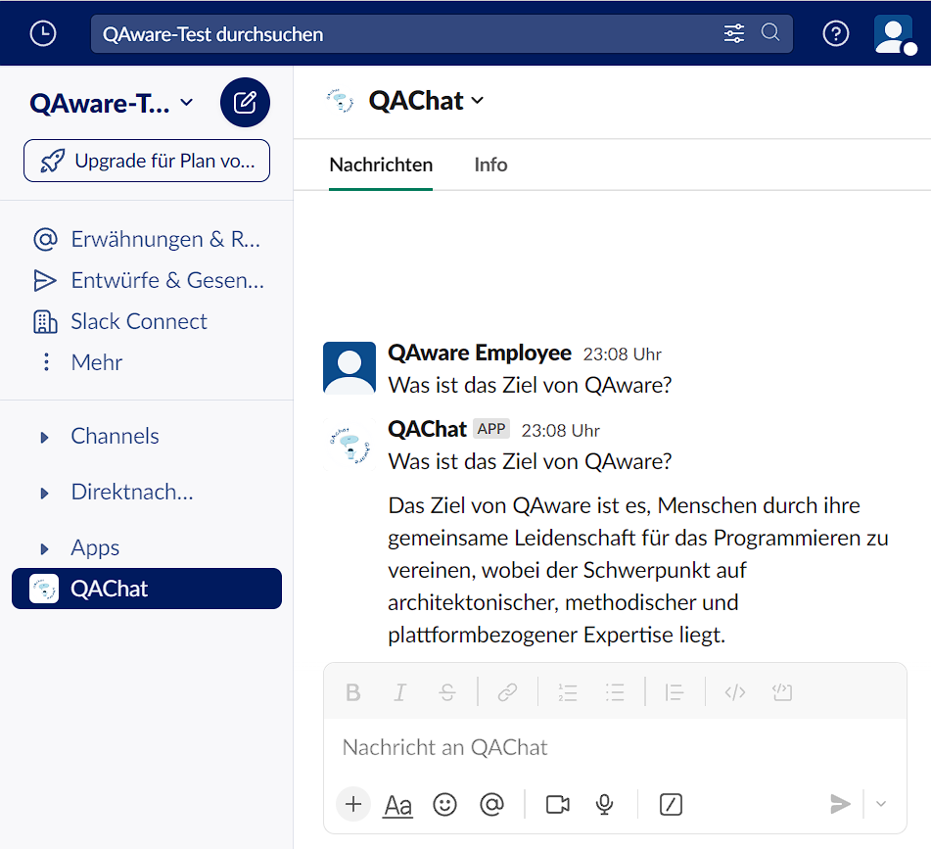
QAChat
Chatbot on slack is based on a LLM and company-internal information.
Data retrieved from company’s Confluence, Slack and Google Drive.
Employees can ask the chatbot questions about the company.
🤖
💾
🗨️

Slide 6
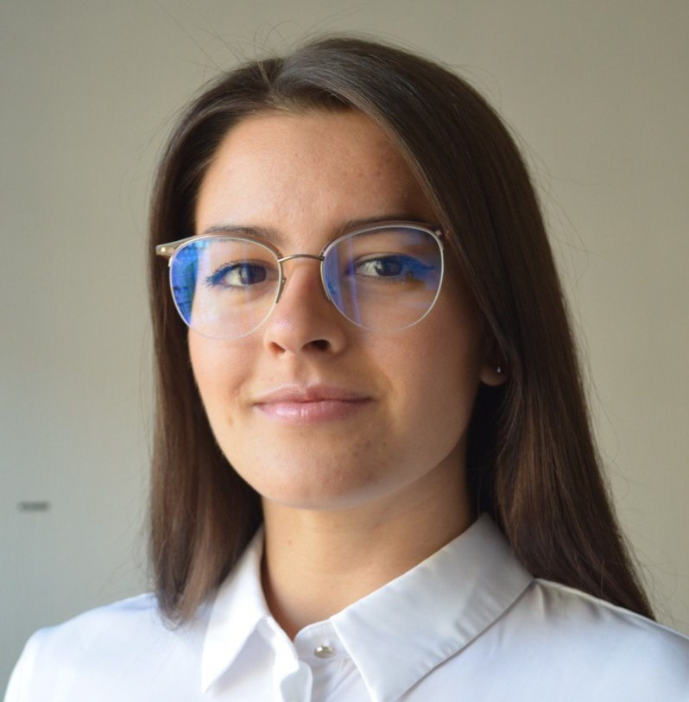

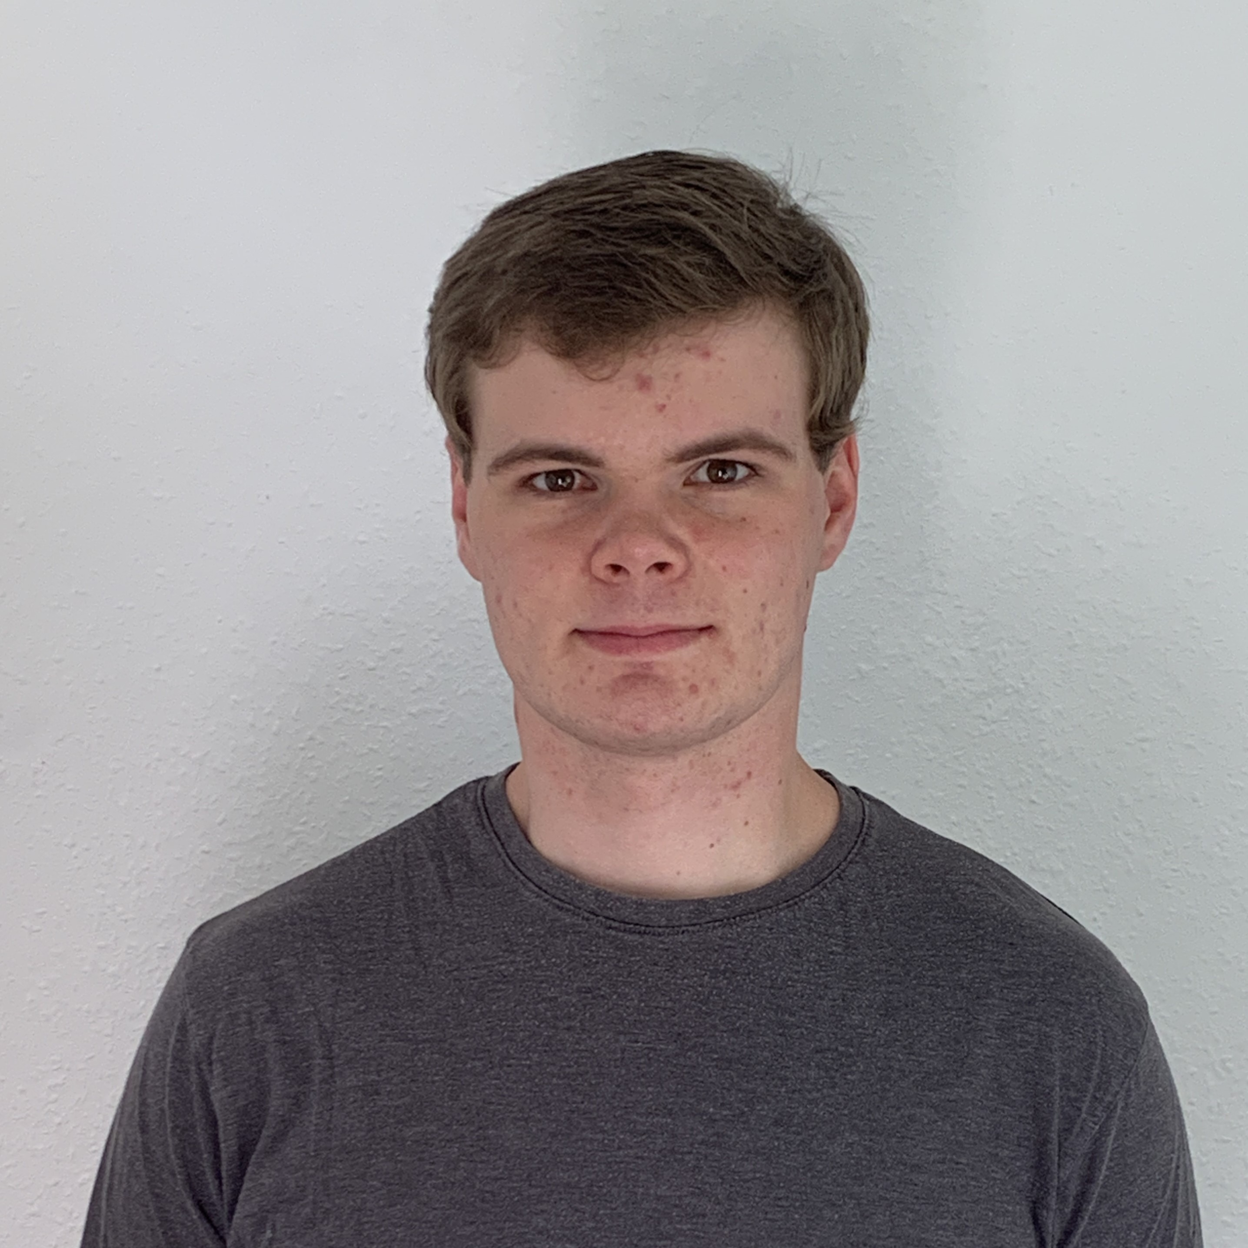
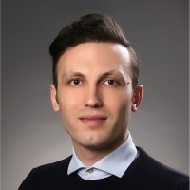
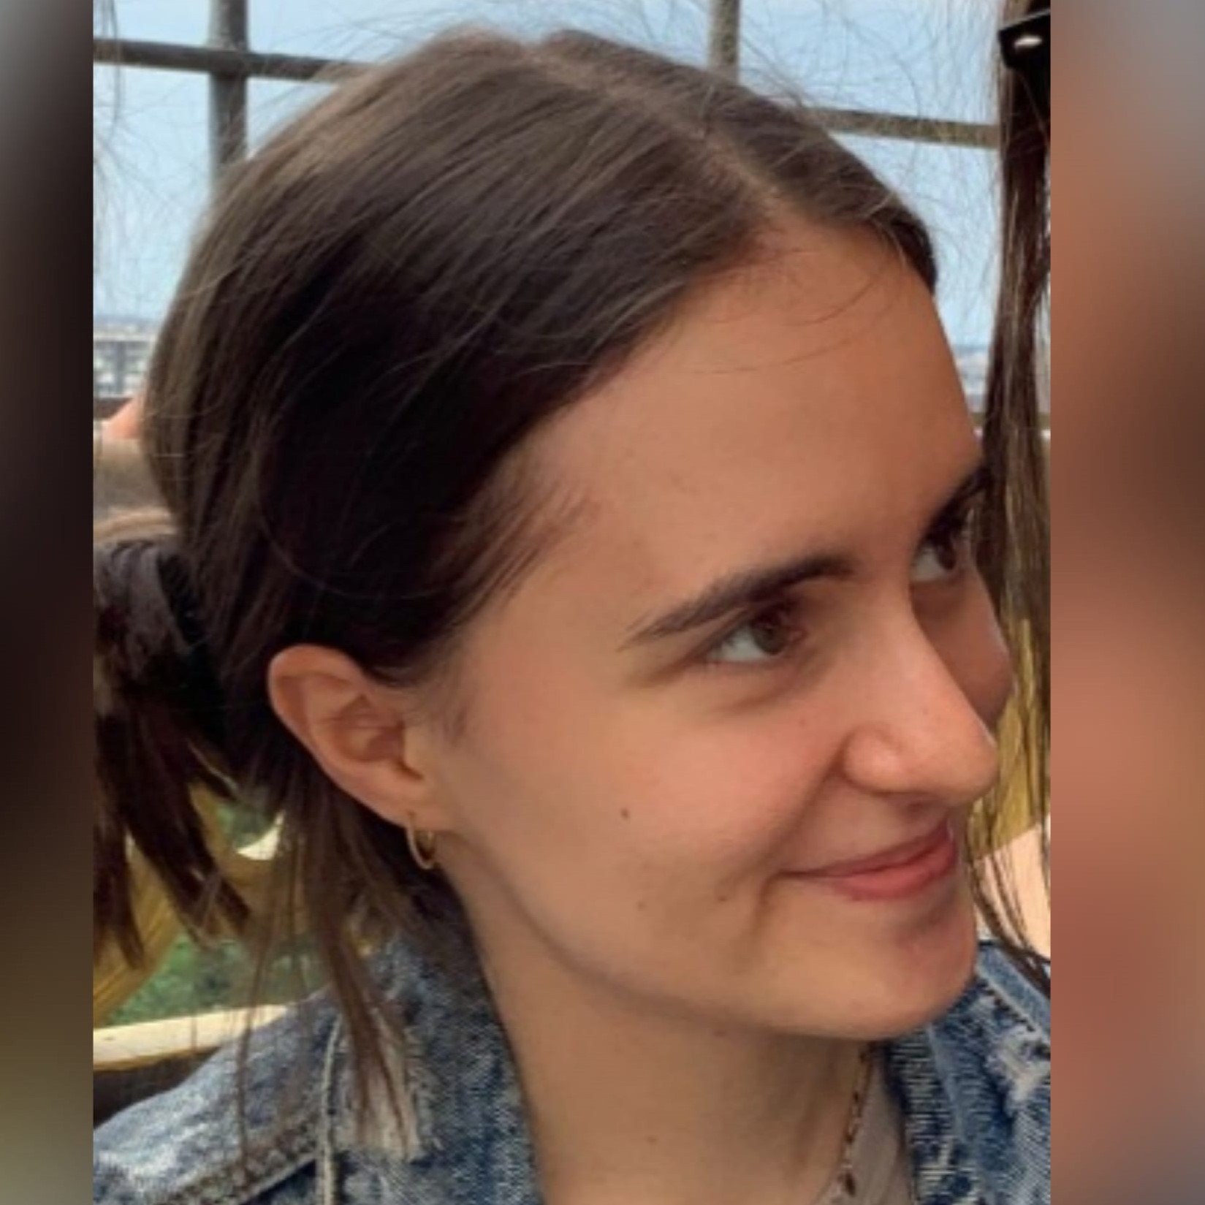


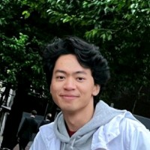

Team
📝 Scrum Master
💼 Product Owner
💻 Software Developer
📝
💼
💼
💻
Vukica
Sara
Tobias
Abdelkader
💻
💻
💻
💻
💻
Amela
Emanuel
Felix
Hafidz
Jesse

Slide 7
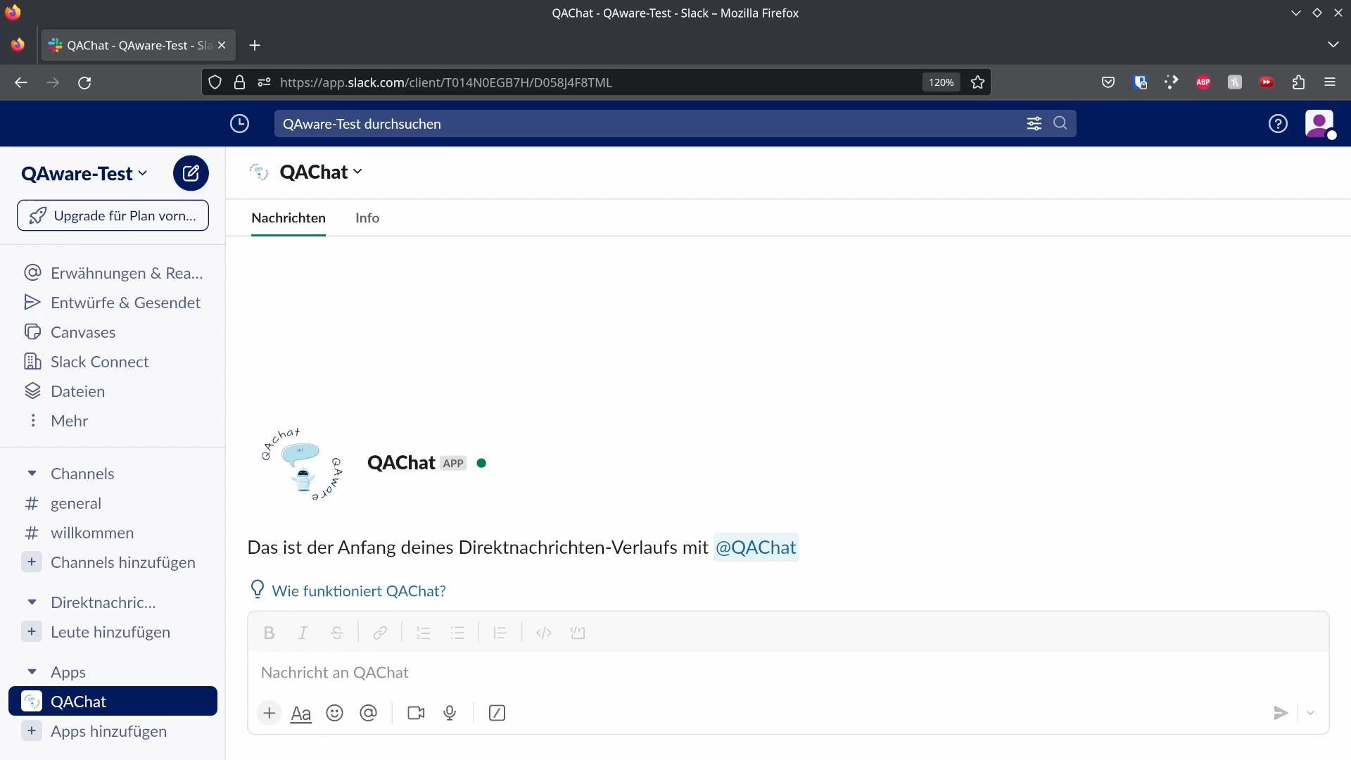
Short Animation Slack Bot

Slide 8



Goal
1. Chatbot must …
1.1 be available as a Slack integration
1.2 be able to respond with company-specific information
1.3 support the German language
3. Policy
Product must only use services that comply with the company's security policy
2. Data retrieval methods must be …
2.1 able to retrieve from Confluence, Slack and Google Drive
2.2 able to work with German text
2.3 able to exclude certain data sources that are on a blacklist
2.4 automated and must run on a schedule

Slide 9








Goal
🤖
🔍
📜
Chatbot
Method
Policy
Notes:
1. Chatbot must …
1.1 be available as a Slack integration
1.2 be able to respond with company-specific information
1.3 support the German language
2. Data retrieval methods must be …
2.1 able to retrieve from Confluence, Slack and Google Drive
2.3 able to exclude certain data sources that are on a blacklist
2.4 automated and must run on a schedule
3. Policy
Product must only use services that comply with the company's security policy

Slide 10
Why not ChatGPT?
🌍
🛡️
💵
Open Source
Privacy
Costs

Slide 11
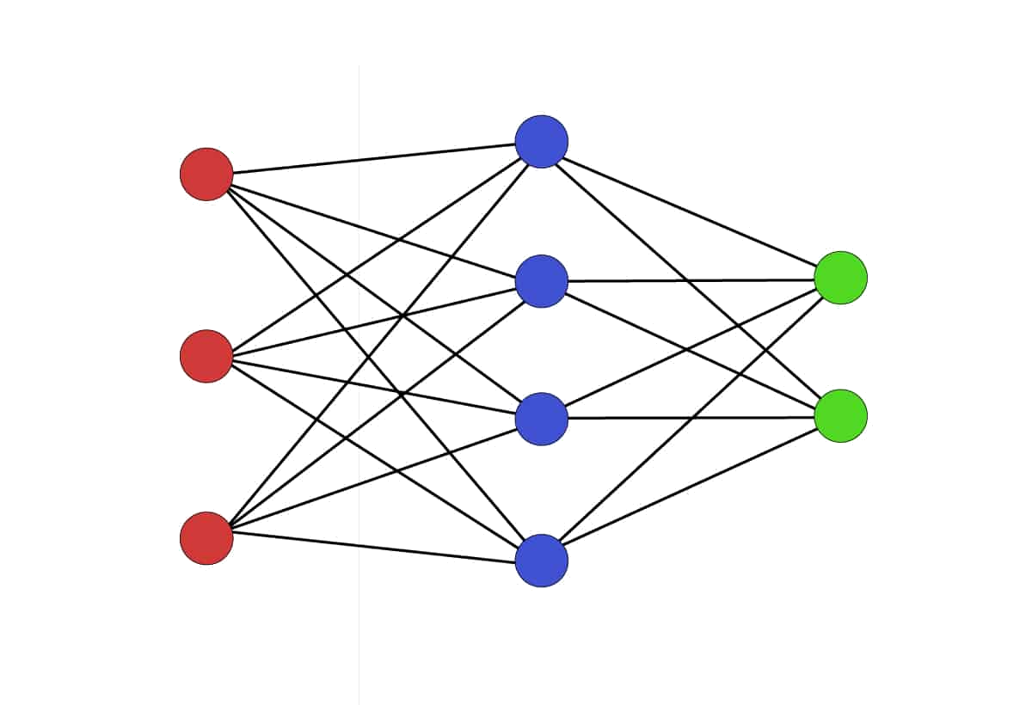
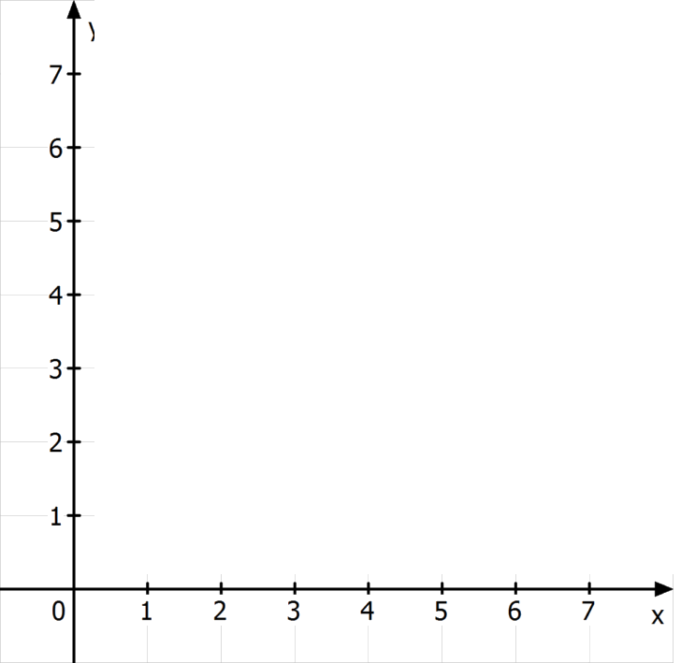
Semantic Search

Slide 12
Semantic Search

Slide 13
Semantic Search

Slide 14
Semantic Search

Slide 15
LLM / Prompt Engineering
TASK DESCRIPTION
CURRENT INPUT
CONTEXT
WizardLM-13B

Slide 16
LLM / Prompt Engineering
"You are a chatbot, your primary task is to help people by answering their questions. " "Keep your responses short, precise, and directly related to the user's question, using the following context to guide your answer:\n" "{context_str}\n\n" "Try your best to answer based on the given context, and avoid creating new information. " "If the context does not provide enough details to formulate a response, or if you are unsure, kindly state that you can't provide a certain answer.\n" "\n\n" "USER: {question}" "ASSISTANT:"
TASK DESCRIPTION
CURRENT INPUT
CONTEXT
WizardLM-13B

Slide 17
LLM / Prompt Engineering
Your primary task is ... Keep your responses short, precise, directly ...
If you are unsure, kindly state ….
TASK DESCRIPTION
CURRENT INPUT
CONTEXT
WizardLM-13B
RESPONSE

Slide 18




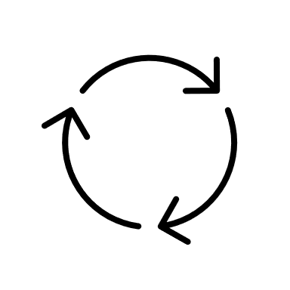




Architecture
Pages
QABot
Data Processing
Messages
Vector Database
Documents

Slide 19

THANK YOU!

Slide 20
THANK YOU!

Slide 21


Slide 22
Architecture
Pages
QABot
Data Processing
Messages
Vector Database
Documents

Slide 23
Architecture
Pages
QABot
Data Processing
Messages
Vector Database
Documents
Demo

Slide 24
DEMO DAY VIDEO (3 min)

Slide 26
QAChat
Chatbot on slack is based on a LLM and company-internal information.
Data retrieved from company’s Confluence, Slack and Google Drive.
Employees can ask the chatbot questions about the company.
🤖
💾
🗨️

Slide 27
QAChat
Chatbot on Slack is based on a LLM and company-internal information.
Data retrieved from company’s Confluence, Slack and Google Drive.
Employees can ask the chatbot questions about the company.
🤖
💾
🗨️

Slide 28
Architecture
Pages
QABot
Data Processing
Messages
Vector Database
Documents

Slide 29
Requirements
1. Chatbot must …
1.1 be available as a Slack integration
1.2 be able to respond with company-specific information
1.3 support the German language
3. Policy
Product must only use services that comply with the company's security policy
2. Data retrieval methods must be …
2.1 able to retrieve from Confluence, Slack and Google Drive
2.2 able to work with German text
2.3 able to exclude certain data sources that are on a blacklist
2.4 automated and must run on a schedule

Slide 30
Demo

Slide 31
QAChat Team
Developer
Developer
Developer
Developer
Developer
Developer
Product Owner
Product Owner
Scrum Master
Abdelkader Abdelkader
Amela Pucic
Emanuel Erben
Felix Nützel
Hafidz Arifin
Jesse Palarus
Sara El Brak
Tobias Konheiser
Vukica Stojkovic
(alphabetical order)

Slide 32
QAChat Team
Scrum Master
Product Owner
Product Owner
Developer
Developer
Developer
Developer
Developer
Developer
Vukica Stojkovic
Sara El Brak
Tobias Konheiser
Abdelkader Alkadour
Amela Pucic
Emanuel Erben
Felix Nützel
Hafidz Arifin
Jesse Palarus
(alphabetical order)

Slide 33
TRASHCAN (not cannot)

Slide 35
Team
📝 Scrum Master
💼 Product Owner
💻 Software Developer

